Slide 1



CN6000
Final Year Project 2025/6
Topic 4
Research Methods

Slide 2
Agenda
Project Approach
SDLC Methodology
Methods
Research Methodology
Quantitative
Qualitative
Different methods explained
We will start with a Case Study:
Authenticate.info

Slide 3

Stop Right There!
Do you need ethical approval?
Week six we will talk about Legal and Ethical Considerations.

Slide 4
Your Project Approach:
Your approach must have two parts:
Practical
Theoretical: Field Research

Slide 5
Your Project Approach:
There are two sections in your Methodology:
SDLC* Methodology: has to be based on known defined IT or Computing methodology and method:
Methodology: Waterfall, SSADM, Agile, RAD, DSDM, Prototyping Approach…etc.
Method: Scrum, Kanban, Wireframe, Javascripts…etc.
*Software Development Life Cycle

Slide 6
Your Project Approach:
There are two sections in your Methodology:
SDLC* Methodology: has to be based on known defined IT or Computing methodology and method:
Methodology: Waterfall, SSADM, Agile, RAD, DSDM, Prototyping Approach…etc.
Method: Scrum, Kanban, Wireframe, Javascripts…etc.
Field Research Methodology: To complement your application
Methodology: Qualitative using themes and text analysis.
Method: Interviews, Focus groups, document analysis, Case Studies….

Slide 7
Your Project Approach:
There are two sections in your Methodology:
SDLC* Methodology: has to be based on known defined IT or Computing methodology and method:
Methodology: Waterfall, SSADM, Agile, RAD, DSDM, Prototyping Approach…etc.
Method: Scrum, Kanban, Wireframe…etc.
Field Research Methodology: To complement your application
Methodology: Qualitative using themes and text analysis.
Method: Interviews, Focus groups, document analysis, Case Studies….
Methodology: Quantitative using statistics analysis
Method: Surveys, Questionnaires, Datasets, may also include Case Studies…

Slide 8


Slide 9
Focus on Quality vs Focus on Quantity

Slide 10
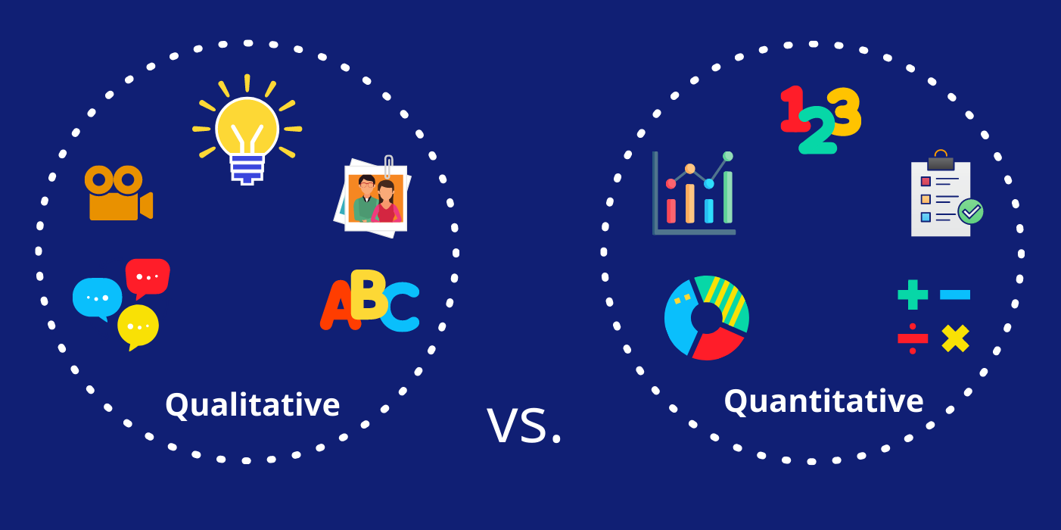

Slide 11


Slide 12
Survey | Interview
Questionnaire | Observation
Datasets | Focus groups
Experiment | Text Analysis
Case Study
Which tool you will use will determine what research you are doing!

Slide 13
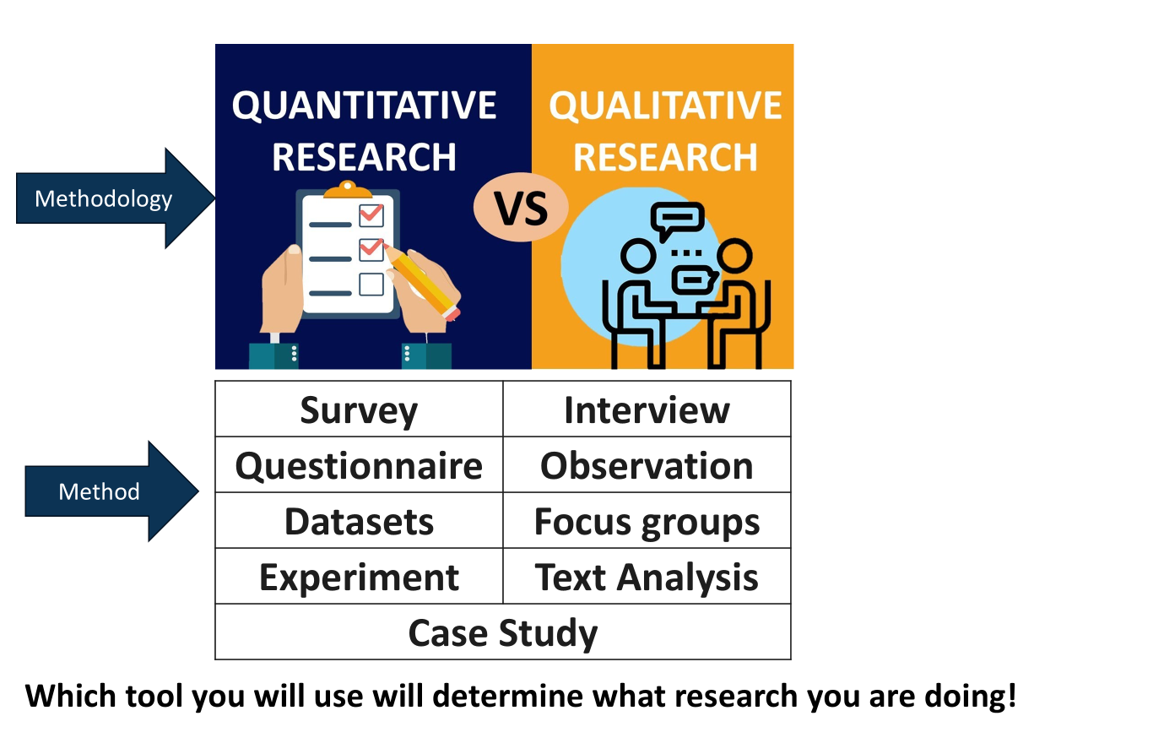

Slide 14
Your Project Approach
SDLC Approach
Field Research
SSADM, Agile, Waterfall…etc
Kanban, Scrum, Gantt chart…etc
Quantitative
Qualitative
Surveys, Questionnaires, datasets…
Interviews, focus groups, Text analysis…etc

Slide 15
Reflect 1:
Your Project Approach
SDLC Approach
Field Research
SSADM, Agile, Waterfall…etc
Kanban, Scrum, Gantt chart…etc
Quantitative
Qualitative
Surveys, Questionnaires, datasets…
Interviews, focus groups, Text analysis…etc
In the next section:
SDLC approaches
Research approaches.
Take 5 mins to write down which approach.
See if you will change your mind as we explain them.

Slide 16
Your Project Approach
SDLC Approach
Field Research
SSADM, Agile, Waterfall…etc
Kanban, Scrum, Gantt chart…etc
Quantitative
Qualitative
Surveys, Questionnaires, datasets…
Interviews, focus groups, Text analysis…etc

Slide 17
SSADM
SDLC ( System Development Life Cycle )
Initiation
Analyse
Plan
Design
Develop
Test
Maintain
Your Project Approach
SDLC Approach
Field Research
SSADM, Agile, Waterfall…etc
Kanban, Scrum, Gantt chart…etc
Quantitative
Qualitative
Surveys, Questionnaires, datasets…
Interviews, focus groups, Text analysis…etc

Slide 18
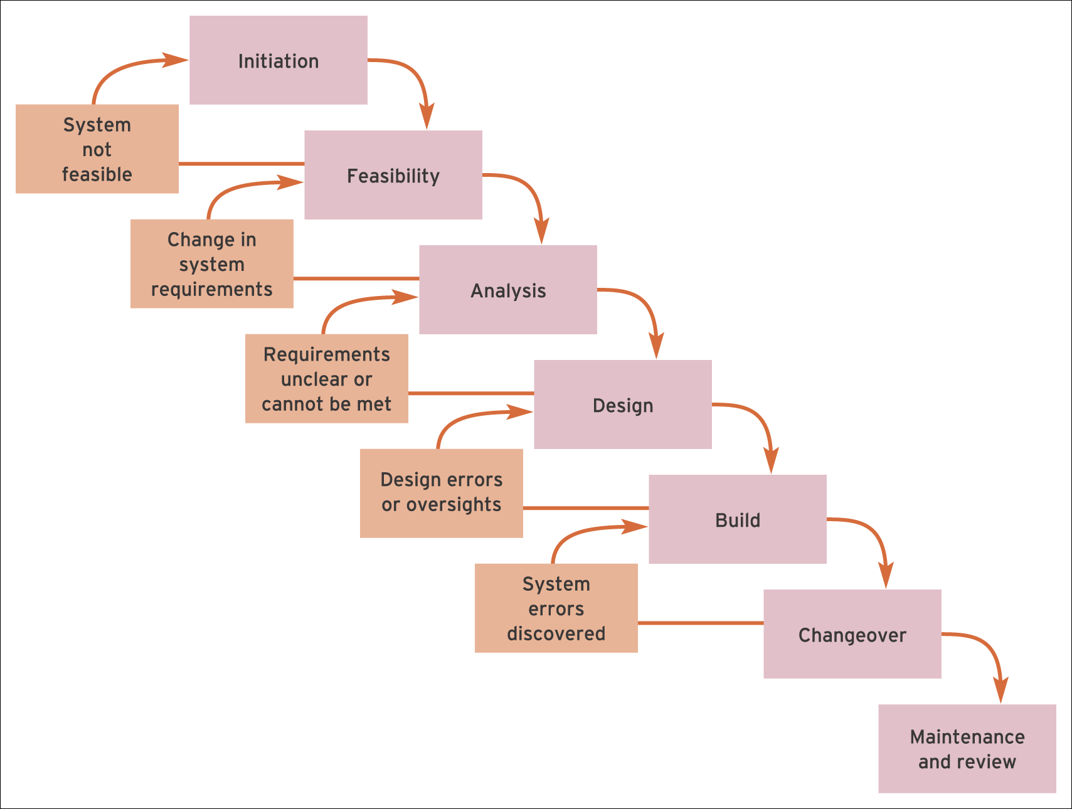
Waterfall
Your Project Approach
SDLC Approach
Filed Research
SSADM, Agile, Waterfall…etc
Kanban, Scrum, Gantt chart…etc
Quantitative
Qualitative
Surveys, Questionnaires, datasets…
Interviews, focus groups, Text analysis…etc

Slide 19
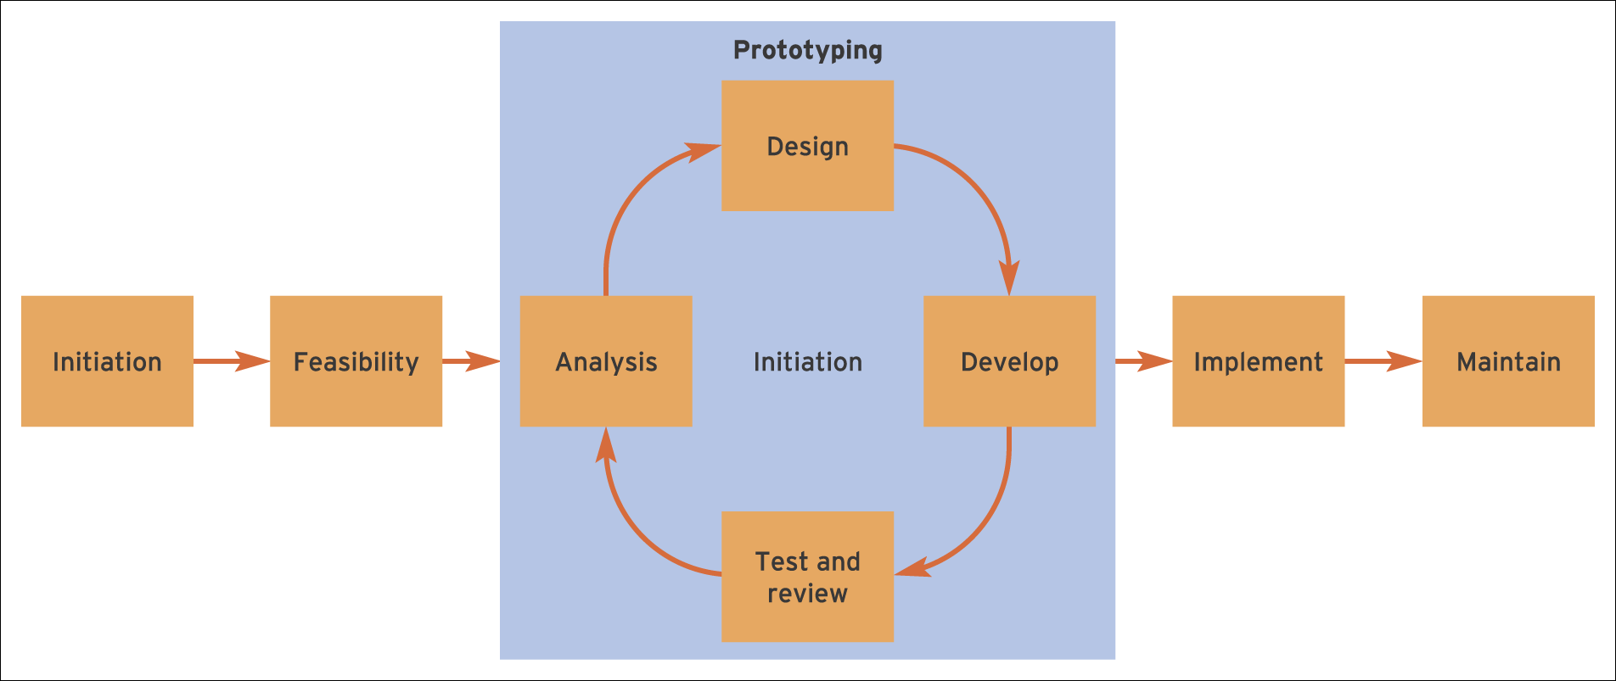
Your Project Approach
SDLC Approach
Field Research
SSADM, Agile, Waterfall…etc
Kanban, Scrum, Gantt chart…etc
Quantitative
Qualitative
Surveys, Questionnaires, datasets…
Interviews, focus groups, Text analysis…etc

Slide 20
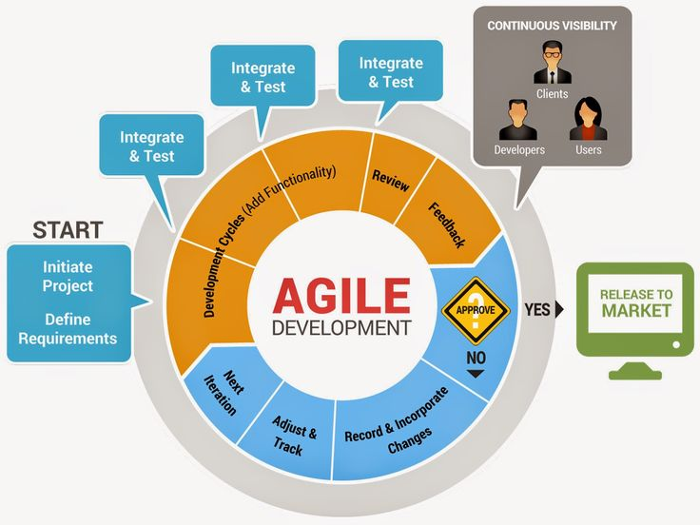
Agile Software Development
Your Project Approach
SDLC Approach
Field Research
SSADM, Agile, Waterfall…etc
Kanban, Scrum, Gantt chart…etc
Quantitative
Qualitative
Surveys, Questionnaires, datasets…
Interviews, focus groups, Text analysis…etc

Slide 21
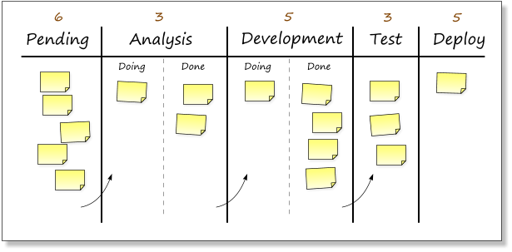
Kanban Boards
Your Project Approach
SDLC Approach
Field Research
SSADM, Agile, Waterfall…etc
Kanban, Scrum, Gantt chart…etc
Quantitative
Qualitative
Surveys, Questionnaires, datasets…
Interviews, focus groups, Text analysis…etc

Slide 22
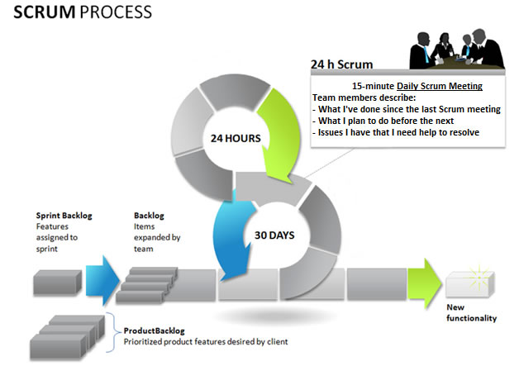
SCRUM Process
Your Project Approach
SDLC Approach
Field Research
SSADM, Agile, Waterfall…etc
Kanban, Scrum, Gantt chart…etc
Quantitative
Qualitative
Surveys, Questionnaires, datasets…
Interviews, focus groups, Text analysis…etc

Slide 23
The lecture explaining these processes are available
These processes were explained in detail in CN4000
You may have forgotten them or need to refresh your memory.
A recording of these methodologies and methods will be available under the ‘Consolidate’ section.

Slide 24
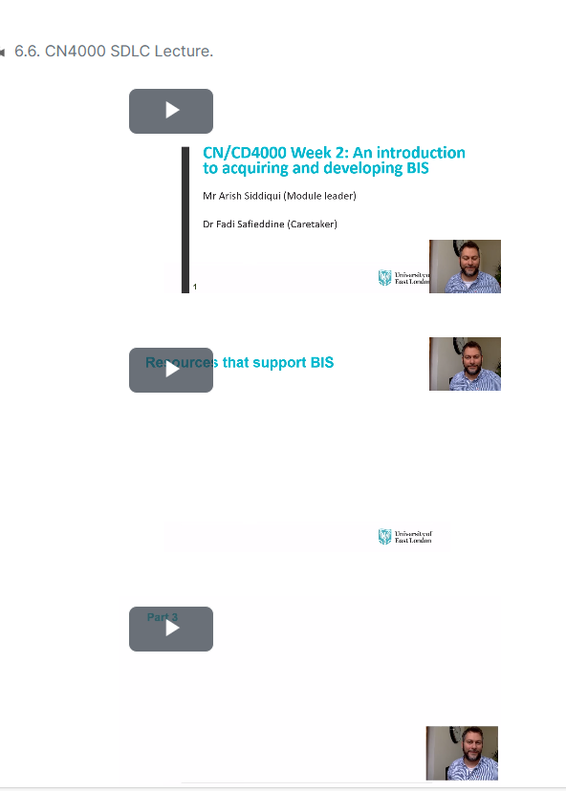
The lecture explaining these processes are available

Slide 25
Field Research Methodology and Methods
Your Project Approach
SDLC Approach
Field Research
SSADM, Agile, Waterfall…etc
Kanban, Scrum, Gantt chart…etc
Quantitative
Qualitative
Surveys, Questionnaires, datasets…
Interviews, focus groups, Text analysis…etc
We can identify two major approaches of field research:
Quantitative:
Common in the fields of natural sciences
Uses numeric scales
Understand how something is constructed /built/works
Qualitative:
Common in the fields of social sciences
Understanding factors and underlining issues.
Common within the field of information science (interviews, observations).

Slide 26
Quantitative method: Surveys
Your Project Approach
SDLC Approach
Field Research
SSADM, Agile, Waterfall…etc
Kanban, Scrum, Gantt chart…etc
Quantitative
Qualitative
Surveys, Questionnaires, datasets…
Interviews, focus groups, Text analysis…etc
This is usually undertaken through the use of questionnaires:
As part of a survey, you might have
to identify samples and sample sizes
to design tailored questionnaires
to define data to be collected
Surveys are the most commonly used research method in undergraduate projects.
We will discuss that more in at later lessons

Slide 27
Example of survey questions
Your Project Approach
SDLC Approach
Field Research
SSADM, Agile, Waterfall…etc
Kanban, Scrum, Gantt chart…etc
Quantitative
Qualitative
Surveys, Questionnaires, datasets…
Interviews, focus groups, Text analysis…etc
Binary
Multiple Choice
Likert
Open ended
Text
Numeric

Slide 28
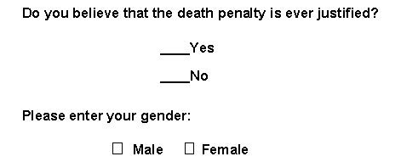
Example of survey questions
Your Project Approach
SDLC Approach
Field Research
SSADM, Agile, Waterfall…etc
Kanban, Scrum, Gantt chart…etc
Quantitative
Qualitative
Surveys, Questionnaires, datasets…
Interviews, focus groups, Text analysis…etc
Binary

Slide 29
Example of survey questions
Your Project Approach
SDLC Approach
Field Research
SSADM, Agile, Waterfall…etc
Kanban, Scrum, Gantt chart…etc
Quantitative
Qualitative
Surveys, Questionnaires, datasets…
Interviews, focus groups, Text analysis…etc
Binary
Binary questions are NOT good questions!!

Slide 30

Example of survey questions
Your Project Approach
SDLC Approach
Field Research
SSADM, Agile, Waterfall…etc
Kanban, Scrum, Gantt chart…etc
Quantitative
Qualitative
Surveys, Questionnaires, datasets…
Interviews, focus groups, Text analysis…etc
Multiple Choice questions

Slide 31
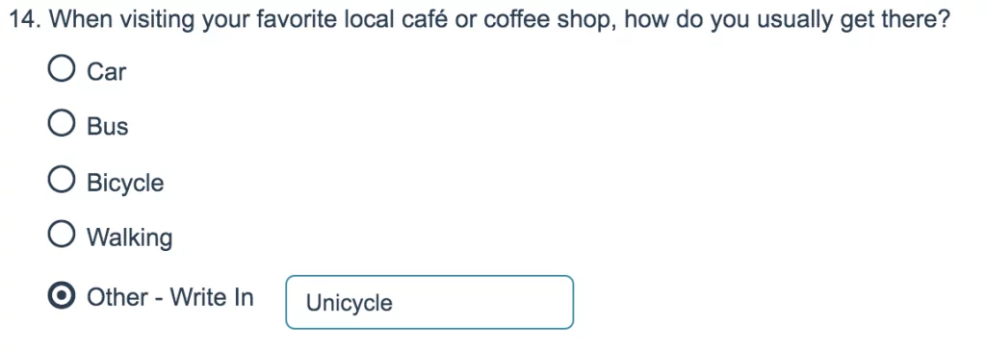
Example of survey questions
Your Project Approach
SDLC Approach
Field Research
SSADM, Agile, Waterfall…etc
Kanban, Scrum, Gantt chart…etc
Quantitative
Qualitative
Surveys, Questionnaires, datasets…
Interviews, focus groups, Text analysis…etc
Multiple Choice questions

Slide 32
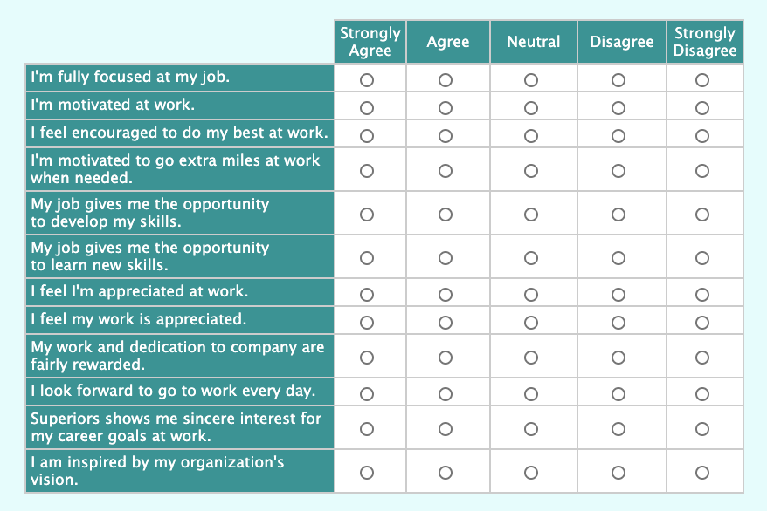
Example of survey questions
Your Project Approach
SDLC Approach
Field Research
SSADM, Agile, Waterfall…etc
Kanban, Scrum, Gantt chart…etc
Quantitative
Qualitative
Surveys, Questionnaires, datasets…
Interviews, focus groups, Text analysis…etc
Likert Questions (5 scale)

Slide 33
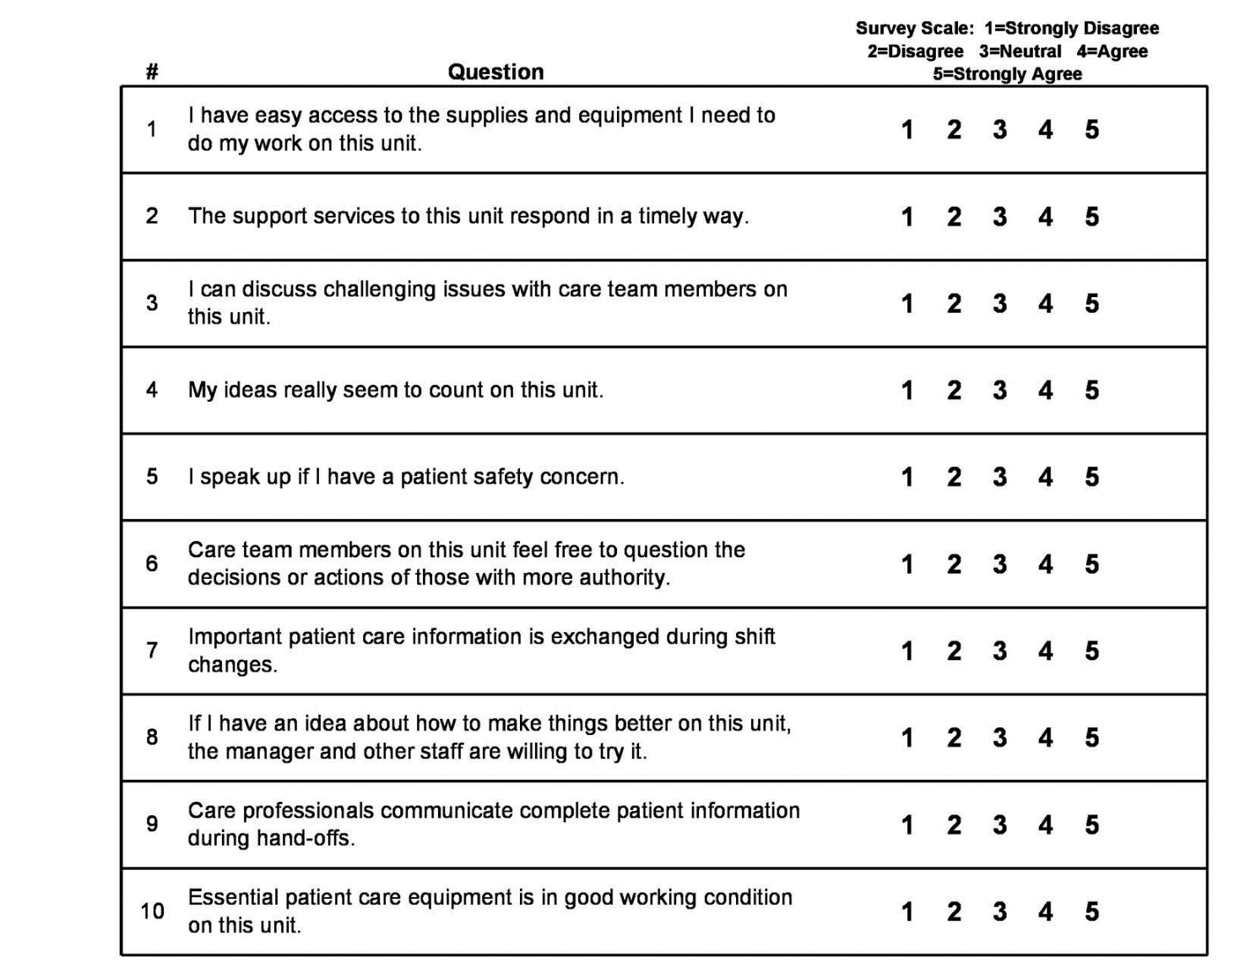
Example of survey questions
Your Project Approach
SDLC Approach
Field Research
SSADM, Agile, Waterfall…etc
Kanban, Scrum, Gantt chart…etc
Quantitative
Qualitative
Surveys, Questionnaires, datasets…
Interviews, focus groups, Text analysis…etc
Likert Questions (5 scale)

Slide 34
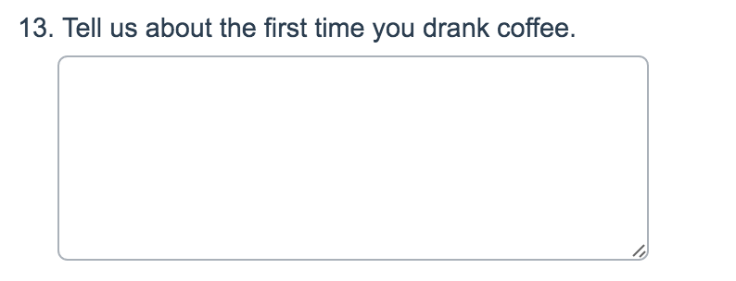
Example of survey questions
Your Project Approach
SDLC Approach
Field Research
SSADM, Agile, Waterfall…etc
Kanban, Scrum, Gantt chart…etc
Quantitative
Qualitative
Surveys, Questionnaires, datasets…
Interviews, focus groups, Text analysis…etc
Some open ended questions

Slide 35
Example of survey questions
Your Project Approach
SDLC Approach
Field Research
SSADM, Agile, Waterfall…etc
Kanban, Scrum, Gantt chart…etc
Quantitative
Qualitative
Surveys, Questionnaires, datasets…
Interviews, focus groups, Text analysis…etc
Some open ended questions
Cannot be used for Qualitative Research!!

Slide 36
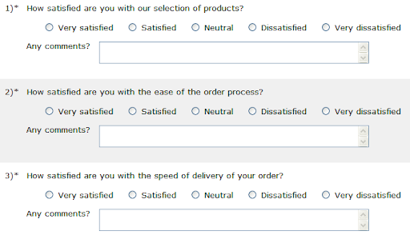
Example of survey questions
Your Project Approach
SDLC Approach
Rfield esearch
SSADM, Agile, Waterfall…etc
Kanban, Scrum, Gantt chart…etc
Quantitative
Qualitative
Surveys, Questionnaires, datasets…
Interviews, focus groups, Text analysis…etc
Some open ended questions

Slide 37
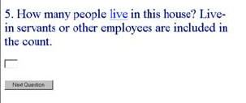
Example of survey questions
Your Project Approach
SDLC Approach
Field Research
SSADM, Agile, Waterfall…etc
Kanban, Scrum, Gantt chart…etc
Quantitative
Qualitative
Surveys, Questionnaires, datasets…
Interviews, focus groups, Text analysis…etc
Numeric

Slide 38
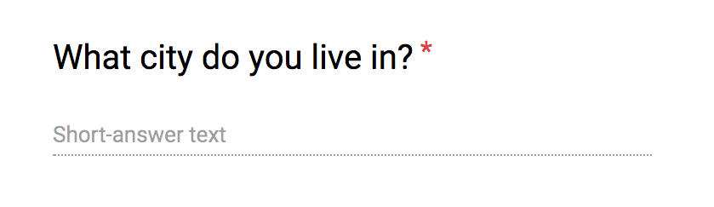
Example of survey questions
Your Project Approach
SDLC Approach
Field Research
SSADM, Agile, Waterfall…etc
Kanban, Scrum, Gantt chart…etc
Quantitative
Qualitative
Surveys, Questionnaires, datasets…
Interviews, focus groups, Text analysis…etc
Textual

Slide 39
Online Surveys

Slide 40
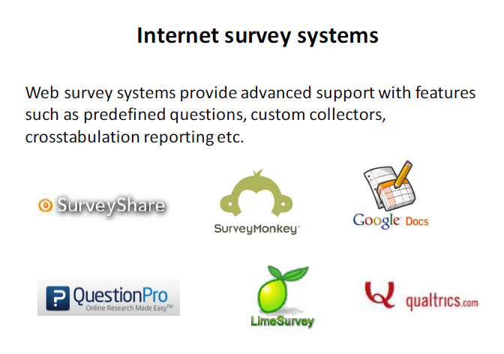

Strongly recommended for UEL

Slide 41
Surveys: Getting Responses
Surveys through questionnaires usually produce very low response rates.
You could contact your subjects beforehand to get their agreement to respond.
Another way of improving your response rate is to offer to send any respondents a summary of the results.
Including a cover letter is also a good way of introducing yourself the purpose of the study.
Surveys do not have to be online! Face to Face surveys.

Slide 42
Reflect 2:
Could you use a survey to validate your design? How many people like your design?
Could you create a survey to see what students ‘really’ want?
Any questions about surveys?

Slide 43
Qualitative Method: Interviews
Your Project Approach
SDLC Approach
Field Research
SSADM, Agile, Waterfall…etc
Kanban, Scrum, Gantt chart…etc
Quantitative
Qualitative
Surveys, Questionnaires, datasets…
Interviews, focus groups, Text analysis…etc
Interviews can be:
Semi-structured
a series of preset questions that you go through with the interviewee,
unstructured
less formal with open-ended questions offering more flexibility in terms of answers.
Unstructured interviews may provide interesting data, but the data is typically more complex to analyze, and hence, it is more challenging to extract useful information.
It is recommended to have ‘semi-structured’ interviews.

Slide 44
Qualitative Method: Interviews
Your Project Approach
SDLC Approach
Field Research
SSADM, Agile, Waterfall…etc
Kanban, Scrum, Gantt chart…etc
Quantitative
Qualitative
Surveys, Questionnaires, datasets…
Interviews, focus groups, Text analysis…etc
You need to put a lot of thought and preparation into your interviews. Here are a few points to take into account when designing your interview.
Selecting interviewees. If you are performing a case study within a company, you might not be able to interview the people you really need to.
Preparation. Have some opening questions ready to ask in an unstructured interview, or carefully prepare a set of questions for a structured interview.
Questions. You could prepare a set of questions and use this as a basis for your interviews. This would ensure consistency when interviewing a number of people.

Slide 45
Qualitative Method: Interviews
Your Project Approach
SDLC Approach
Field Research
SSADM, Agile, Waterfall…etc
Kanban, Scrum, Gantt chart…etc
Quantitative
Qualitative
Surveys, Questionnaires, datasets…
Interviews, focus groups, Text analysis…etc
Confidentiality. You MUST guarantee the interviewee’s confidentiality, if appropriate.
Consider whether the information they are providing is confidential to their company.
May need to arrange some sort of confidentiality clause or disclosure agreement.
Consider what happens to the transcript of the interview and also what you will be able to reproduce in your report.
Logistics of the session. You will need to arrange the interview, the time, location and duration. Be aware that this can take time to organize as people are very busy.

Slide 46
Qualitative Method: Interviews
Your Project Approach
SDLC Approach
Field Research
SSADM, Agile, Waterfall…etc
Kanban, Scrum, Gantt chart…etc
Quantitative
Qualitative
Surveys, Questionnaires, datasets…
Interviews, focus groups, Text analysis…etc
Characterization. You might be interviewing several people during the course of your study, and they may have different backgrounds (technical, personal, etc.).
You should consider how their background might influence their responses.
When you perform an interview, interviewees need to be able to trust you, and you should not betray that trust!
Without trust, your interviewee may not provide you with the depth of detail you hope to achieve.

Slide 47
Some Examples of Interview Questions
Always ask yourself: Do you need that question? How will it help you answer your research?
Do you find the existing system helps you get the job done?
Can you give me examples of features of the existing system that you don’t like?
Roughly how often do you and your colleagues make mistakes entering order details?
Which type of mobile app would best meet your needs? An HTML 5 based application or a native application?
Who is responsible for setting network security policy within your organisation?
Tell me what you like about the system?

Slide 48
Surveys and Interviews: Drafts and pilot test
Whatever approach you decide to take, you HAVE TO check it with your supervisor and try it out with a limited number of people (classmates) to see what feedback you receive.
You might then redraft the questions in light of these responses (rephrase questions, restructure the layout, and so on).
And finally,
Avoid leading questions.
Avoid jargon. The users may not understand what you mean or have a different interpretation of you,
Avoid asking questions that could be difficult to answer.

Slide 49
Field Research Methods: Case Studies
Your Project Approach
SDLC Approach
Field Research
SSADM, Agile, Waterfall…etc
Kanban, Scrum, Gantt chart…etc
Quantitative
Qualitative
Surveys, Questionnaires, datasets…
Interviews, focus groups, Text analysis…etc
An in-depth exploration of a situation:
It involves the investigation of a particular situation, problem, company or group of companies. This investigation can be performed:
directly (interviews, observation),
indirectly (study of reports or documentation).
In a case study, the purpose is not to simply report on the outcome of the case study investigation.
A proper case study also requires analysis and generalisation from the specific details of the examined situation.

Slide 50
Research Methods: Case Studies (cont.)
Your Project Approach
SDLC Approach
Field Research
SSADM, Agile, Waterfall…etc
Kanban, Scrum, Gantt chart…etc
Quantitative
Qualitative
Surveys, Questionnaires, datasets…
Interviews, focus groups, Text analysis…etc
You should also be aware of your own influence on the case study if it is performed directly.
For example, when you interview people:
did they tell you what they felt you wanted to hear rather than the facts of the situation?
are there any means of obtaining data from two or three different sources to confirm the truth in what you are told?

Slide 51
Reflect 3:
Could you use an interview to validate your design? Show them and collect feedback.
Could you use interviews to see what students ‘really’ want?
Any questions about interviews?

Slide 52
Examples:
Newham Health App?

Slide 53
Examples:
Newham Health App?
Agile Approach using Gantt chart, Kanban using Zoho Creator.
Qualitative Approach using
Focus group invite five residents interested in this app as to what they would like to have features in this app.
Review feedback other local health apps have on the App stores.

Slide 54
Examples:
Newham Health App?
Waterfall Approach using Scrum and Network Planning using AppSheet.
Quantitative Approach using
Survey of 50 Newham resident students about their health habits.
Survey of facilities in Newham.

Slide 55
Can we combine Qualitative and quantitative in research?
Newham Health App?
Waterfall Approach using Scrum and Wireframe using HTML5 & Javascripting.
Quantitative Approach using
Survey of 50 Newham resident students about their health habits.
Survey of facilities in Newham.
Qualitative Approach using
Focus group invite five residents interested in this app as to what they would like to have features in this app.
YES
It is correct but you will not have enough time!

Slide 56
Examples:
Newham Health App?
Waterfall Approach using Scrum and Network Planning using AppSheet.
Quantitative Approach using
Survey of 50 Newham resident students about their health habits.
Survey of facilities in Newham.
OR
Qualitative Approach using
Focus group invite five residents interested in this app as to what they would like to have added features.
Better stick to one only

Slide 57
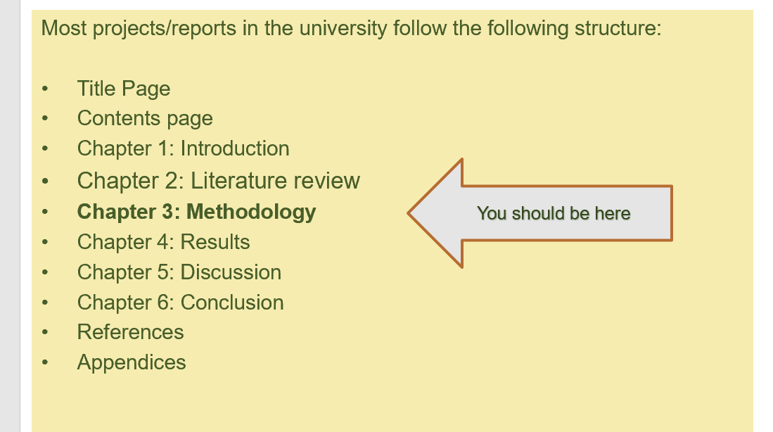
Where do you write your Approach?
You write it in chapter 3: Methodology!

Slide 58

Methodology:
Typical Structure of a Methodology:
Chapter 3: Methodology
3.1. Introduction:
…
….
3.2. Approach::<<define the implementation and research approaches>>
…
3.3. Implementation:
3.3.1. SDLC: Agile
….
3.3.2. Method: Wireframes, E-R, PHP and Javascripts
…
3.4. Research Approach:
3.4.1. Literature
…..
3.4.2. Quantitative Approach using Survey
…..
3.5. Challenges and limitations:
…..
3.9. Ethical Considerations:
……

Slide 59
Homework!
Explore the other tools we could not cover in detail today:
Watch CN4000 recordings of SDLC
Research other tools: Focus Groups, Observation, Questionnaires…etc.
Decide your approach with the support of your supervisor!

Slide 60
Learning Objectives
Upon completion of this topic, you should be able to:
Distinguish between the various research methods of relevance to computing projects.
Identify the circumstances in which you would apply each of the methods to a computing project.
Select and apply research methods that are appropriate to your project.

Slide 61
Directed Reading
Dawson, C.W., 2015. Projects in computing and information systems: a student's guide. Pearson Education. Chapter 2
SurveyMonkey. nd. Avoid Bad Survey Questions: Loaded Question, Leading Question. [ONLINE] Available at: https://www.surveymonkey.com/mp/5-common-survey-mistakes-ruin-your-data/. [Accessed 02 October 2021].

